Slide 1
Divisions of the Nervous System

Slide 2
What are we doing today?
The nervous and endocrine systems work together to co-ordinate functions of all body systems, but differ in terms of:
speed of action
duration of action
nature and transmission of the message
specificity of message (SU)
Structure and function of the divisions of the peripheral nervous system
autonomic and somatic
sympathetic and parasympathetic
afferent and efferent

Slide 3
Keywords
Central:
Peripheral:
Afferent:
Efferent:
Autonomic:
Somatic:
Sympathetic:
Parasympathic:

Slide 4
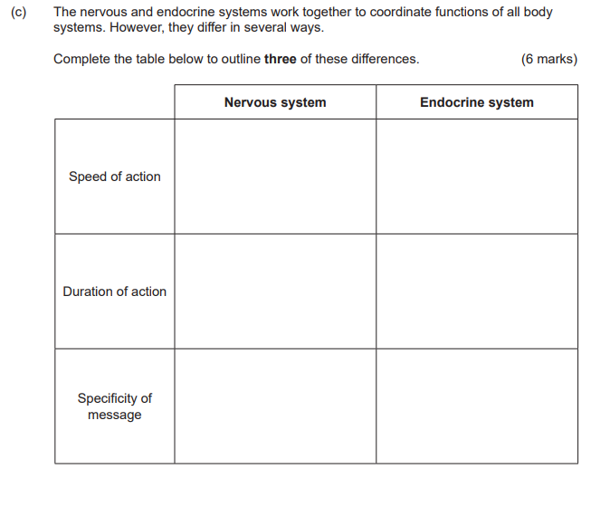

Slide 5
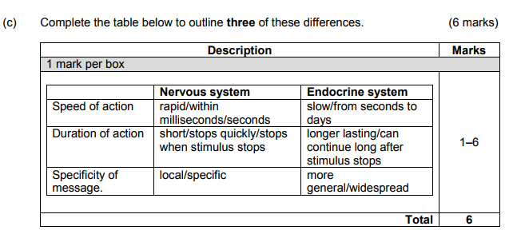
Answer

Slide 6
Divisions of the nervous system
Nervous System
Central NS (CNS) (Brain-Spinal cord)
Peripheral NS (PNS)
Afferent (Sensory NS)
Efferent NS
Somatic (motor) NS
All voluntary
Autonomic NS (ANS)
All involuntary
Parasympathetic NS
Sympathetic NS

Slide 7
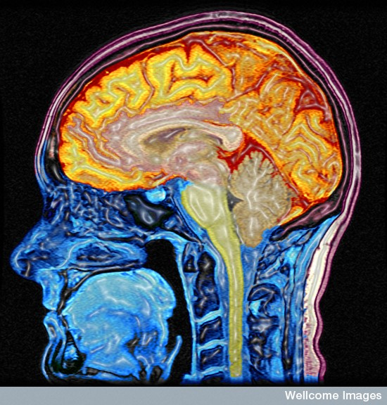
The central nervous system
The central nervous system consists of the brain and the spinal cord
M Lythgoe, C Hutton, Wellcome Images

Slide 8
The peripheral nervous system
The peripheral nervous system consists of all the nerves in the body, outside the central nervous system.
Peripheral nerves may be:
Afferent (sensory), taking nerve impulses from receptors to the central nervous system.
Efferent (motor), taking nerve impulses from the central nervous system to effectors. Efferent nerves can be somatic (volutary)or autonomic (involutary).

Slide 9
Features of afferent (sensory) neurones
Take nerve impulses from receptors to CNS
Mostly unipolar with the cell body lying off to one side of the axon
Cell body in dorsal root ganglion
Pass through dorsal root of spinal nerves
Sensory receptors occur at end of dendrites
Axons synapse with connector neurones in spinal cord.

Slide 10
Features of efferent (motor) neurones
Take nerve impulses from CNS to effectors
Mostly multipolar with a single long axon
Cell body in grey matter of spinal cord
Pass through ventral root of spinal nerves
Effector structures (muscles or glands) occur at end of axons
Dendrites synapse with connector neurones in spinal cord
Can be somatic (voluntary) or autonomic (involuntary)

Slide 11
Somatic Nervous System
The Somatic Nervous System :
Is usually voluntary
Responds to external environment
Carries nerve impulses to skeletal muscles
Consists of one neurone-no synapse or ganglion
Neurotransmitter is acetylcholine

Slide 12
Autonomic Nervous System
The Autonomic Nervous System :
Is involuntary
Helps maintain homeostatic balance
Carries nerve impulses to involuntary glands and internal organs
May be sympathetic (fight or flight) or parasympathetic (normal functioning)
Consists of two neurones form efferent chain (pre- and post-ganglionic neurones)
Neurotransmitter could be acetylcholine or noradrenaline

Slide 13
The sympathetic division
The sympathetic division of the autonomic nervous system:
Enables the body to respond to stress (fight or flight response) – throws the body out of homeostatic balance.
Arise with spinal nerves in the lumbar and thoracic regions of the spine.
The neurotransmitter is noradrenaline.

Slide 14
Parasympathetic division
The parasympathetic division of the autonomic nervous system:
Is involved with normal body functioning
(maintains homeostatic balance).
Arise with cranial nerves from the brain and spinal nerves in sacral region of the spine (= cranio-sacral outflow).
The neurotransmitter is acetylcholine (ACh).

Slide 15
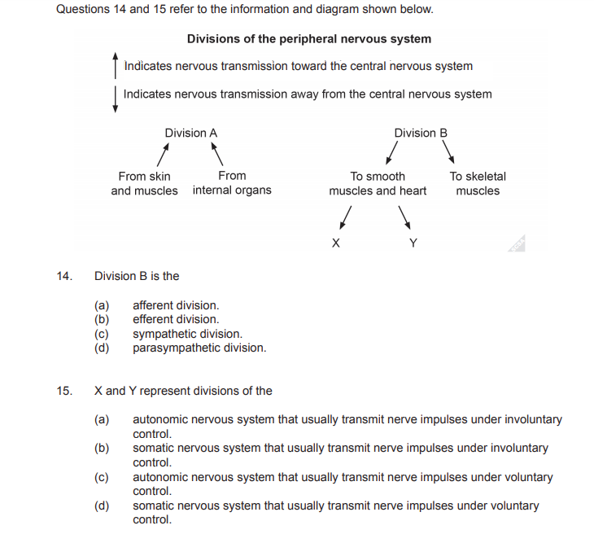

Slide 16

Answers

